Slide 1
TDR Technical Assessment
19.01.2024
Lakshmanan Balasubramanian

Slide 2
Problem
Store the data that you have been given in a suitable format. You need to include approximately 10 rows of sample data, based on the sample row given above. It should include at least the information shown above but can include any extra information you think necessary.
Develop a program to meet the minimum requirements below:
Calculating and displaying in a suitable format the average grade for each student, highlighting whether the student achieves a Pass (40%+), merit (60%+), or distinction (70%+).
Providing an average result for each student or a selection of students.

Slide 3
Demonstration

Slide 4





Technical Stack
Client-Side
Server-Side
Database
React
NodeJs
MongoDB
MUI
ExpressJs

Slide 5
Technical Stack
Client-Side: ReactJS was used for the client-side due to its robust and efficient handling of dynamic user interfaces leading to a more streamlined development process. Additionally, React's virtual DOM feature ensures better performance and faster rendering, making it ideal for interactive applications.
Back-end: Node.js combined with Express.js was selected for their efficiency in handling asynchronous requests and scalability. Express.js adds a layer of simplicity and flexibility, allowing for rapid development of RESTful APIs and server-side logic.
Database: MongoDB was chosen due to its document-oriented, NoSQL nature, which provides flexibility in handling data structures. This is particularly advantageous for applications with evolving data requirements.

Slide 6
Code Discussion

Slide 7
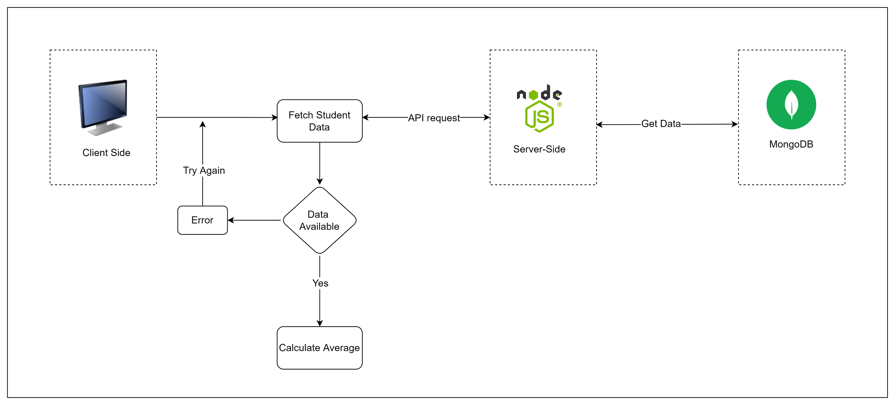
Design

Slide 8
Future Scope

Slide 9
Future scope
Personalized Student Portal: Implement a feature where students can log in to view their academic results and submit coursework, offering a tailored and interactive academic experience.
Faculty Coursework Management: Create an interface for faculty members to download, review, and grade student submissions, providing an efficient and organized approach to coursework evaluation.
Examination Board Control: Grant the examination board administrative privileges to manage mark entries and regulate access, ensuring the integrity and coordination of the academic evaluation process.
Mobile Application: Develop a mobile app version of the portal to increase accessibility and convenience, catering to the needs of users who prefer mobile platforms.
Calendar Integration for Deadlines: Integrate coursework deadlines with users' calendars for automated reminders, aiding in better time management and planning for both students and faculty.

Slide 10
Thank You

